Slide 1






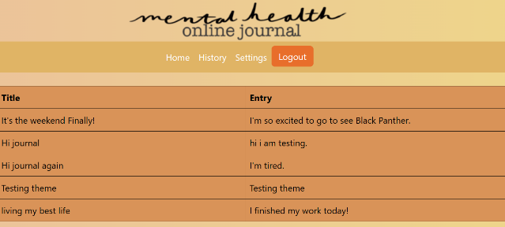
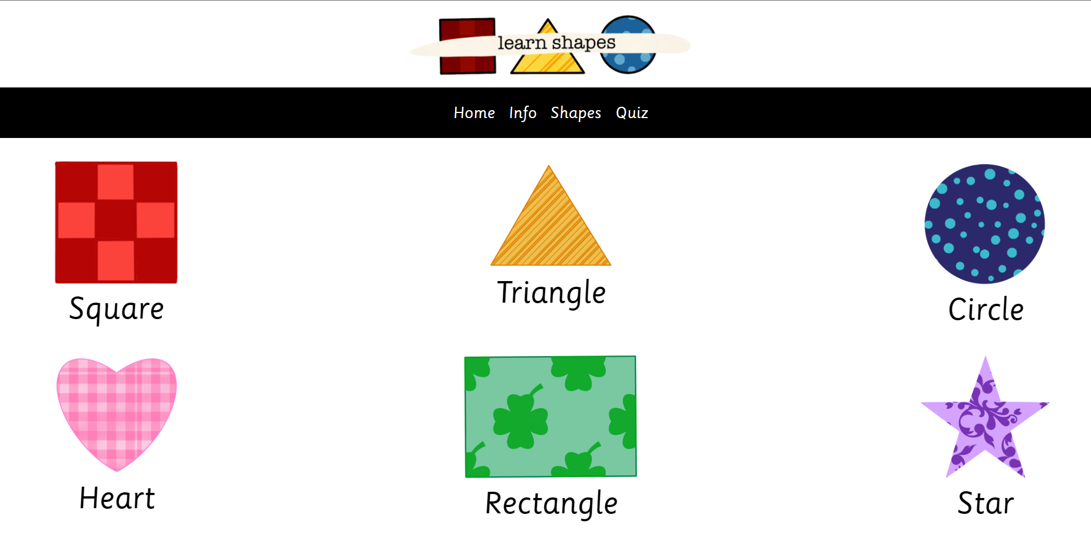
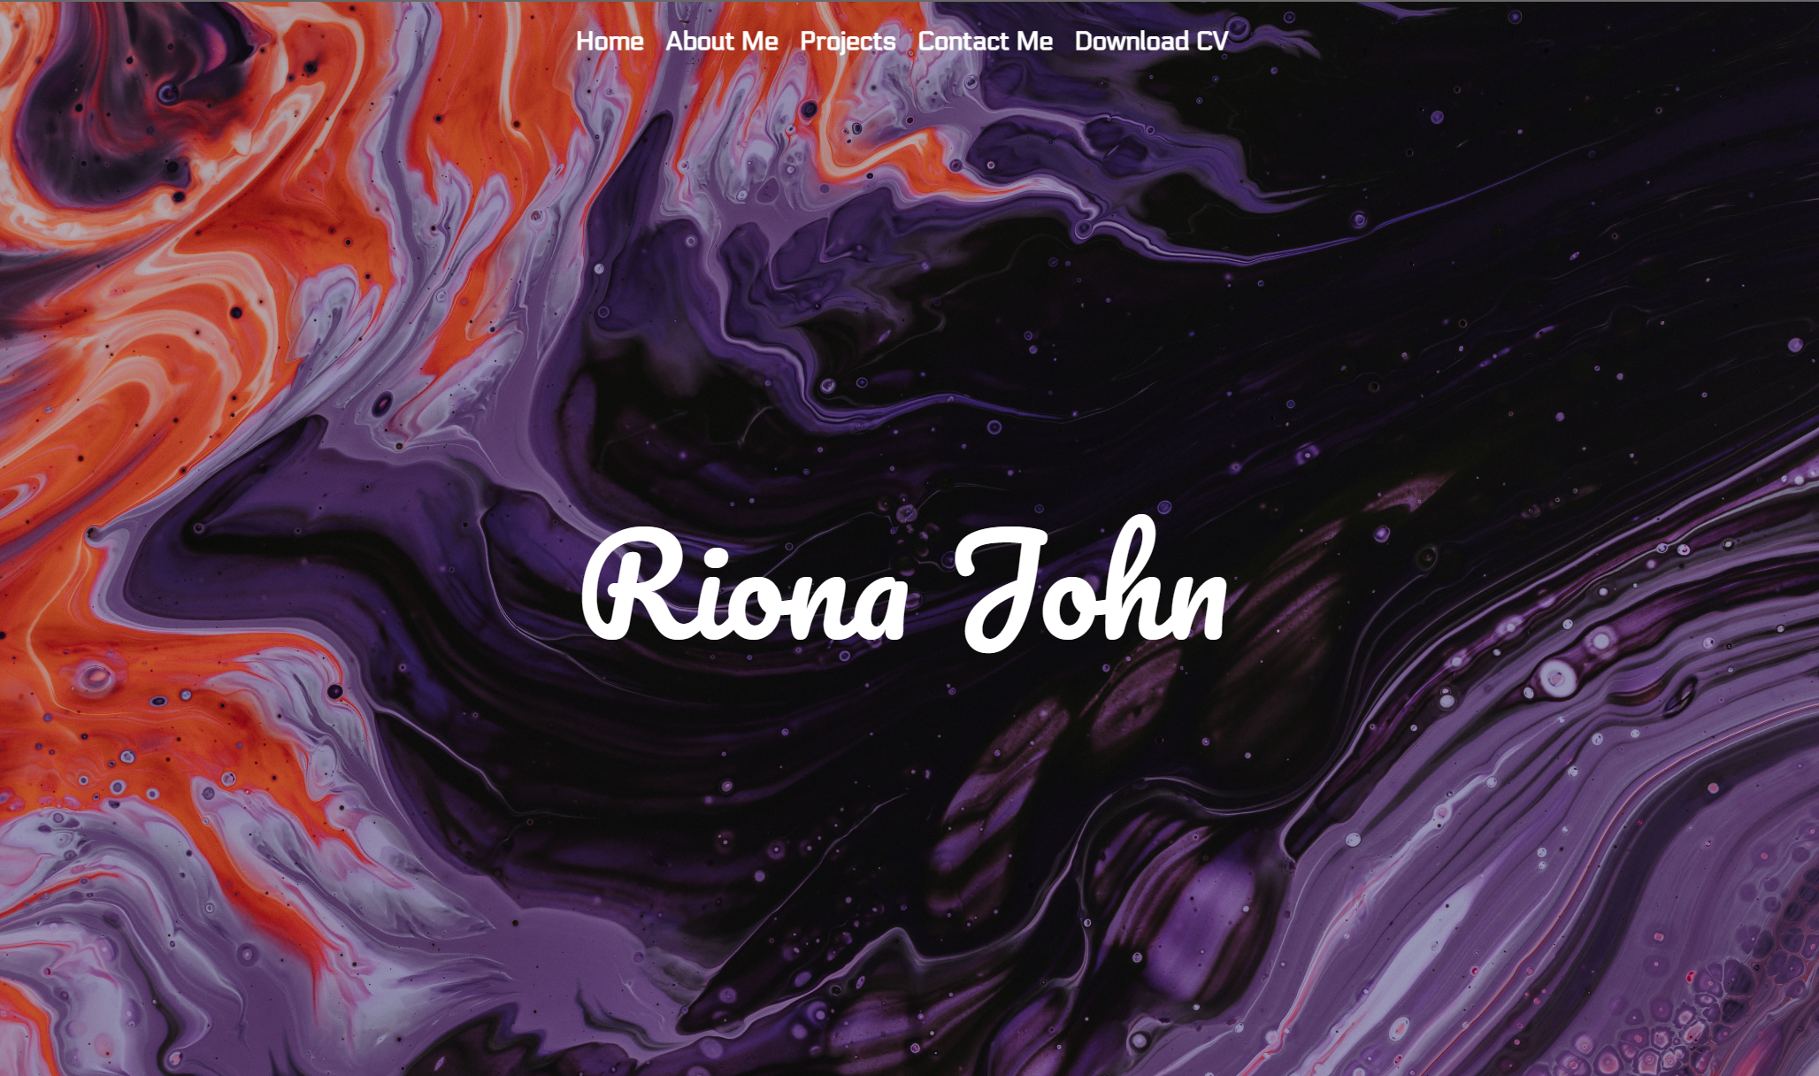
A Study in Human Computer Interaction (HCI)
Riona John | Zhaohui Lao | Royal Holloway, University of London
Project Overview
dsd
Research
Wireframes
Site Maps
Implement
System Testing
User Feedback
Mental Health Online Journal
A Parent-Guided Shape Learning Tool
A Personal Portfolio
Notes:
To change this poster, replace our sample content with your own. Or, if you'd rather start from a clean slate, press the New Slide button on the Home tab to insert a new page. Now enter your text and pictures in the empty placeholders. If you need more placeholders for titles, subtitles or body text, copy any of the existing placeholders, then drag the new one into place.

